Slide 1
Class Project:
Weight loss and Self-esteem
Hyun Jin Ku
April 24th, 2020

Slide 2
Abstract
The purpose of this project was to investigate the answer to the following question:
Is losing weight an effective way to improve individual’s self esteem?
From the data, I used the method of multiple regression model to conduct the test, and I set self-esteem values as the response and weight loss and group as the predictor variables. Group is a factor with levels, and the levels are Control, Diet, and DietEx. Diet group are the group which only did diet for 3 weeks, and DietEx group did diet along with exercise. I figured out that the amount of weight loss does work significantly in the model only during the second week according to the anova test for B1=0. In summary, my result can be interpreted as the amount of weight loss is significant variable in predicting the self-esteem measure during the second week of the experiment, and the level of group is significant during the first and the second week of the experiment, and none of the predictor variables are significant during the last week.

Slide 3
Introduction
According to the source provided by Harvard School of Public Health, obesity causes and is linked to various health conditions including physical effects such as heart disease or diabetes; On the other hand, it also causes serious psychological and problems such as depression.
Through this project, I wanted to figure out the relationship between weight loss and the change of one’s self-esteem. The analysis to this data will answer if one’s low self-esteem is caused by not losing that much weight, if one’s weight loss can help improving his or her self-esteem. The analysis will be done using the method of Linear Regression.

Slide 4
Materials and Methods
The dataset includes 34 observations, and there are total of 7 variables which are group, wl1, wl2, wl3, se1, se2, and se3. The variable “group” indicates the type of experiment that the participant of the study went through. This consists of 3 levels, which are Control, Diet, and DietEx. People in Control group neither cut down their meals nor exercised, people in Diet only cut down their meals, and people in DietEx controlled their meals and did exercise as well. The results were collected week by week until the third weeks so there are weight loss data for 1,2,3 week and self-esteem data for 1,2,3 week.

Slide 5
Materials and Methods Cont.
Using R, I conducted 3 linear models for each week, and obtained weightloss1, weightloss2, and weightloss3 by setting self-esteem variable as predicted y and weight loss variable and group as predictors. I also set group variable as factor since this is consisted of levels. Then, I looked at the data obtained by performing summary function and anova function.

Slide 6
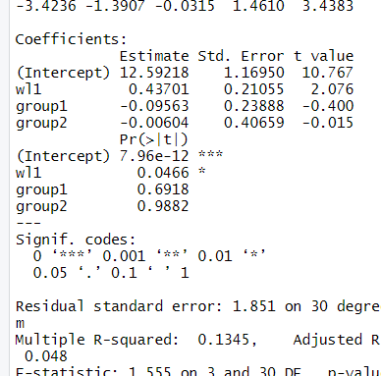
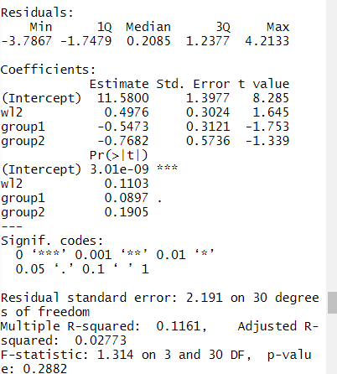
Summary(weightloss1), Summary(weightloss2)
1 increase of a unit in weight loss of week 1 leads to 0.43701 increase in self-esteem.
1 increase of a unit in weight loss of week2 leads to 0.4976 increase in self esteem.

Slide 7
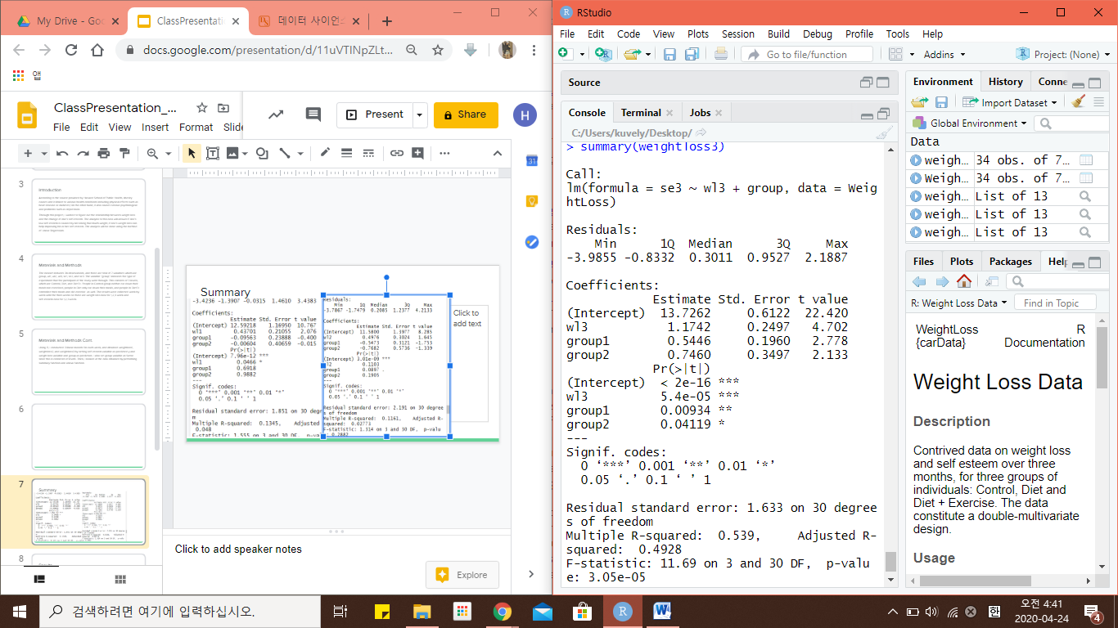
Summary(weightloss3)
1 increase of a unit in weight loss of week3 leads to 1.1742 increase in self-esteem.

Slide 8
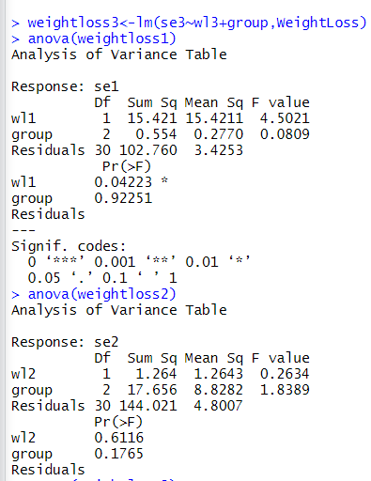
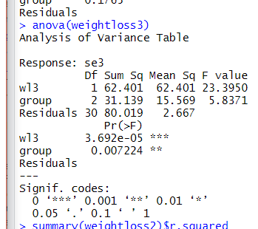
anova(weightloss1), anova(weightloss2), anova(weightloss3)
According to the F test,
H0 : B(weightloss)=0 for week one was rejected, meaning weight loss of week 1 is statistically interpreted as not equal to 0. Weightloss for week 1 is not significant factor in the model.
The hypothesis for group predictor could not be rejected, and this means that there isn’t a sufficient evidence for group predictor to be 0.
According to the F test,
H0 : B(weightloss)=0 for week two is rejected at 0.01 significance level, meaning there is not enough evidence that the hypothesis of B1 = 0 is true. This also applies to group predictor.
Lastly,
H0 : B(weightloss)=0 for week three is failed to be rejected at 0.01 significance level, meaning there is enough evidence that B(weightloss) is not 0. This applies to group predictor as well.

Slide 9
Results
Result shows that B(wl) for week one = 0.43701, B(w2) for week two = 0.4976, and B(wl3) for week three = 1.1742.
According to anova, wl1’s hypothesis of H0: B(weightloss1) = 0 could not be rejected. H0:B(group)=0 was rejected at the same significance level.
w2’s hypothesis of H0:B(weightloss2)=0 and H0:B(group) = 0 were both failed to be rejected.
W3’s hypothesis of H0:B(weightloss3)=0 and H0:B(group)=0 were both rejected.

Slide 10
Discussion
According to the results, 1 unit increase in weight loss predictors of each week predicted to result in somewhat increase in the response value, which is self-esteem.
Weight loss predictor has been interpreted as a significant variable in the model in 1 and 3 week since H0 were rejected. Group predictor has been interpreted as a significant variable in 2 and 3 week, which is quite inconsistent.
Overall, I could tell the increase in self esteem does go along with increase in the amount of weight loss, but the influence of exercise and diet on the individual was quite hard to tell.

Slide 11
Literature Cited
https://www.hsph.harvard.edu/obesity-prevention-source/obesity-consequences/
http://www.csun.edu/~ata20315/psy524/main.htm

